Slide 1
Explore Dataflow in Deep Learning Accelerator(DLA)
b08901093 莊詠翔

Slide 2
Outline
Timeloop
DLA and Dataflows
Eyeriss
TPU
NVDLA
Simulation setup
Comparision

Slide 3
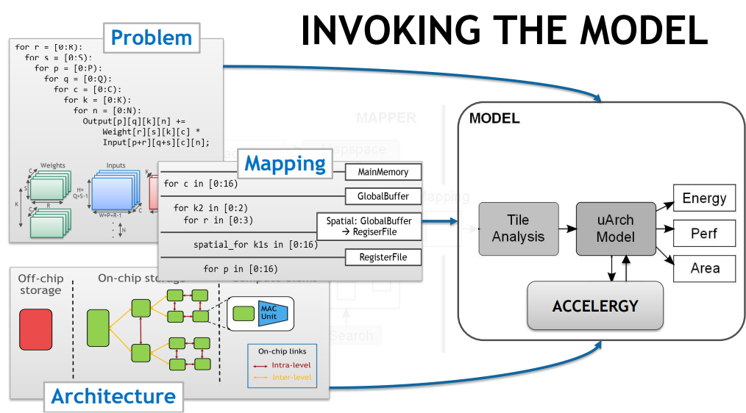
What can Timeloop do? (1/2)
For a specific DLA design, Timeloop can give various estimations, such as Energy, Area and Timing.

Slide 4
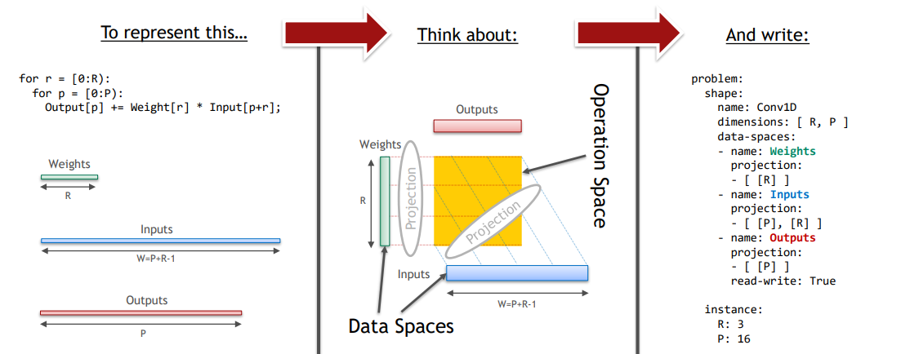
Inputs-Problem
Problem
Determine the size and shape of a convolution problem.

Slide 5
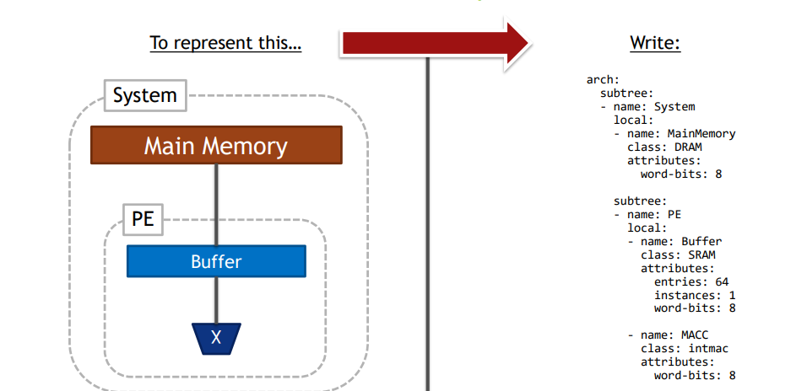
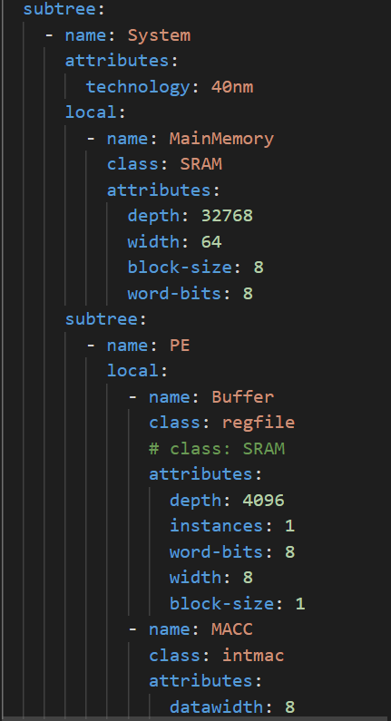
Inputs-Architecture
Architecture:
The Hardware specification, including memory and MACs.

Slide 6
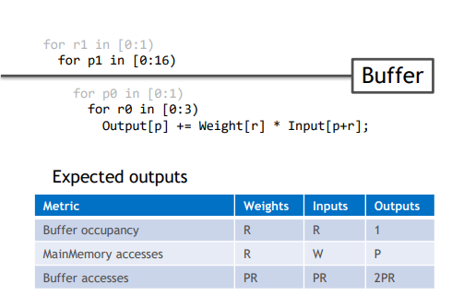
Inputs-Mapping
Input buffer
Input buffer
Input buffer
1
2
3
4
5
6
7
8
9
10
11
12
13
14
15
16
17
18
1
2
1
3
1
2
3
2
3
Mapping
Specify the way of data movements.
Architecture
Problem
Mapping
read/write

Slide 7
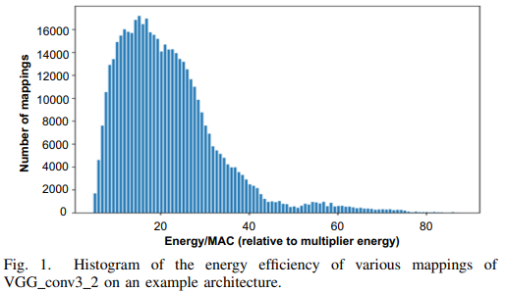
Mapping
Find a good way to schedule operations and determine data movements.
Different Mapping results in different characteristics of hardware design.

Slide 8
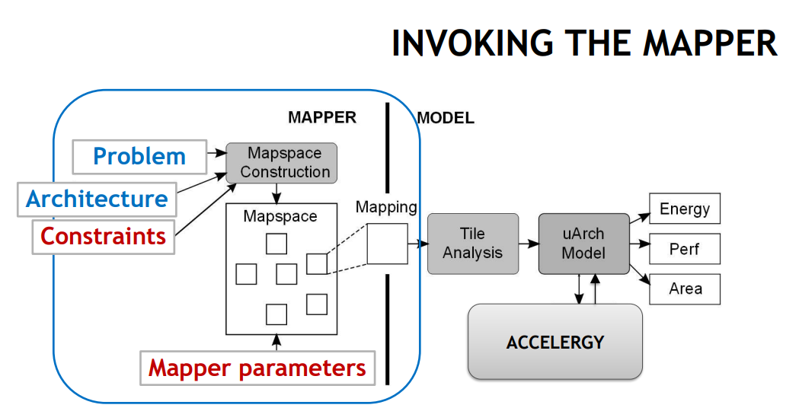
What can Timeloop do? (2/2)
Timeloop systematically constructs a mapspace and walks through the mappings in it to find the optimal mapping for a specific architecture.

Slide 9
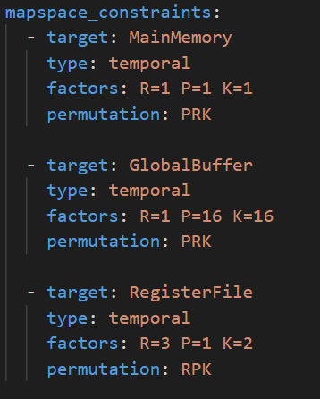
Inputs-Mapping Constraints
Permutation
The order of dimensions when doing calculation
Factor
Split a specific dimension between different hardware
Bypass
Determine which data should/shouldn’t be store in a specific memory
Use constraints to simulate a specific dataflow!

Slide 10
Dataflows
Take 3 popular DNN accelerator design for simulation:
Eyeriss from MIT
TPU from Google
NVDLA from NVIDIA

Slide 11
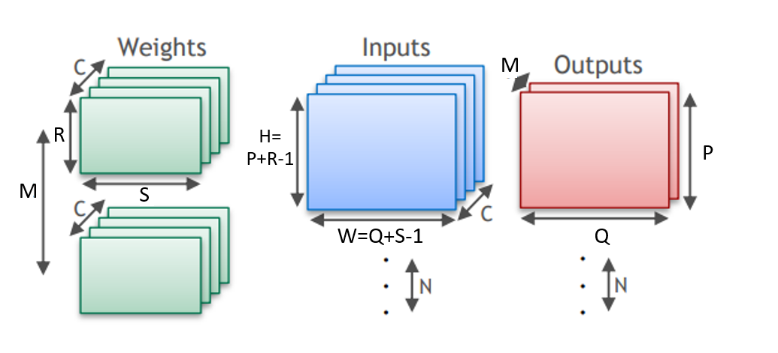
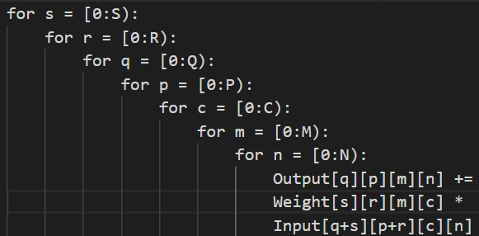
Define the problem
First, we define parameters in a convolution calculation as follow:

Slide 12
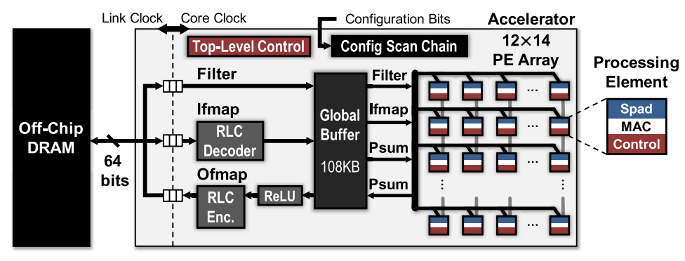
Eyeriss
168 processing elements (PEs) that creates a four-level memory hierarchy
DRAM, GLB, PE-PE links, Spad

Slide 13
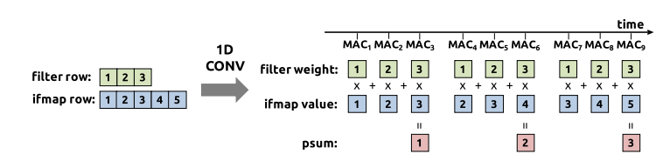
Row Stationary dataflow
RS dataflow first divides the computation into 1-D convolution primitives.
Calculate 1-D Convolution primitive:
A primitive operates on one row of filter weights and one row of ifmap values, and generates one row of psums.
Notes:
By mapping each primitive to one PE for processing, the computation of each row pair stays stationary in the PE.
each PE can use the local spads for both convolutional data reuse and psum accumulation. Since only a sliding window of data has to be retained at a time, the required spad capacity depends only on the filter row size (S) but not the ifmap row size (W),

Slide 14
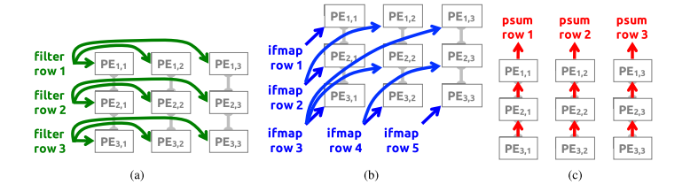
2-D Convolution PE Set
Shares the same row of filter or ifmap across primitives.
Accumulates the psums from multiple primitives.
Data reuse in a set(with PE-PE links):

Slide 15
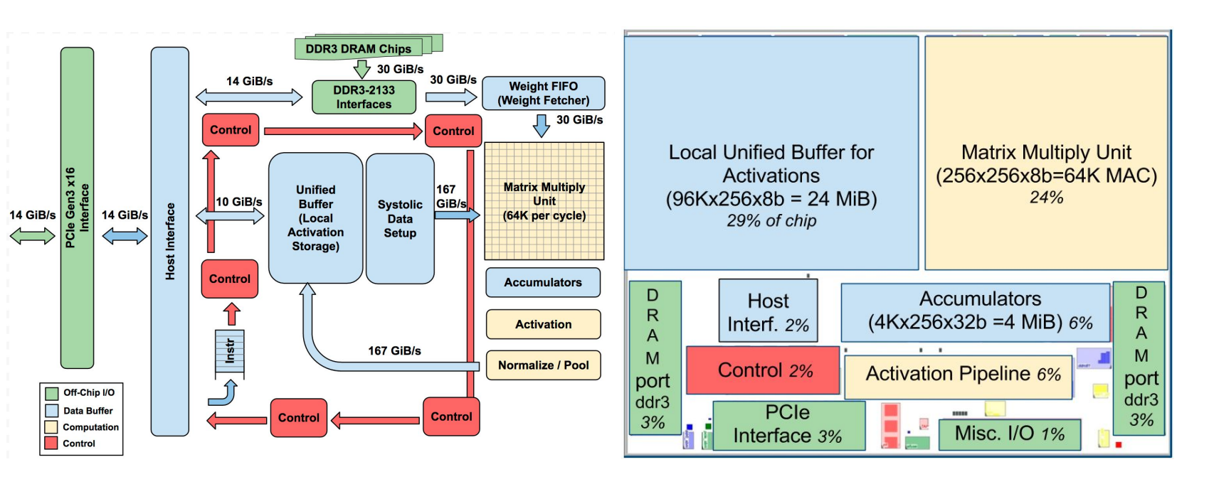
TPU
Off-chip DRAM, GLB for input and output, weightSpad

Slide 16
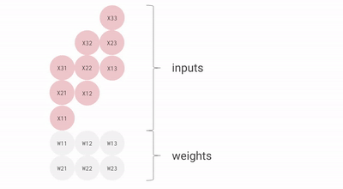
Systolic array
Wires only connect spatially adjacent ALUs
Inputs are reuse vertically (spatial)
Weight stationary

Slide 17
TPU-like Architecture
No input_spad since TPU only load and store weight in the PEs.
PsumReg store temporal partial sum to simulate the accumulator.
The word-bits is 16 rather than 8 (for comparison with other architecture).
DRAM
GLB
PE
PE
PE
WeightReg
WeightReg
WeightReg
MAC
MAC
MAC
PsumReg
PsumReg
…
PsumReg

Slide 18
NVDLA
Direct Convolution: Split a convolution calculation into multiple MAC of small cubes.

Slide 19
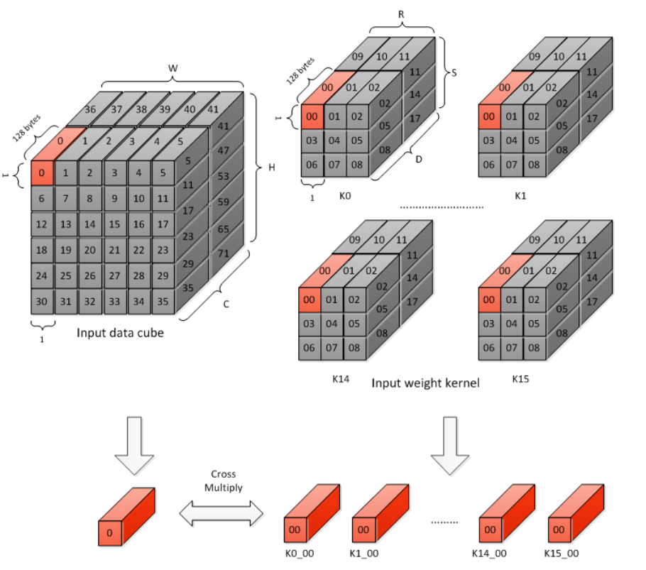
Atomic operation
Divide all input/weight data cubes into 1x1x64 element small cubes.
Multiply one small input data cube by one small weight data cube.
64 MACs are needed in a MAC cell.

Slide 20
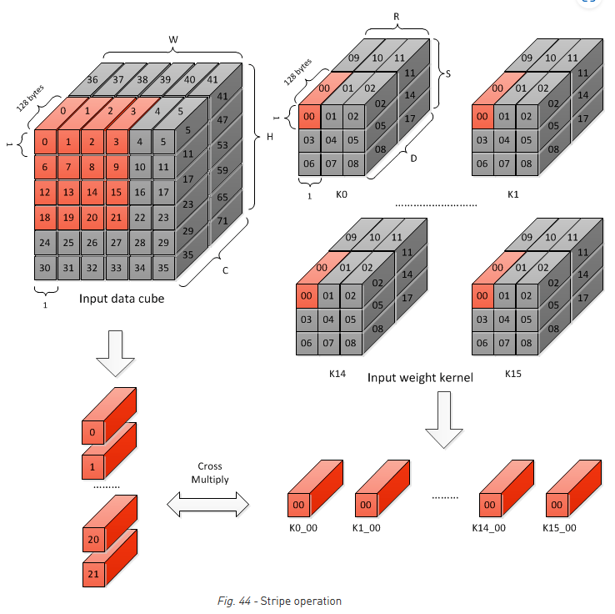
Stripe operation
Weight data in each MAC cell array is kept unchanged (thus weight stationary). Input data slides along input data cube.

Slide 21
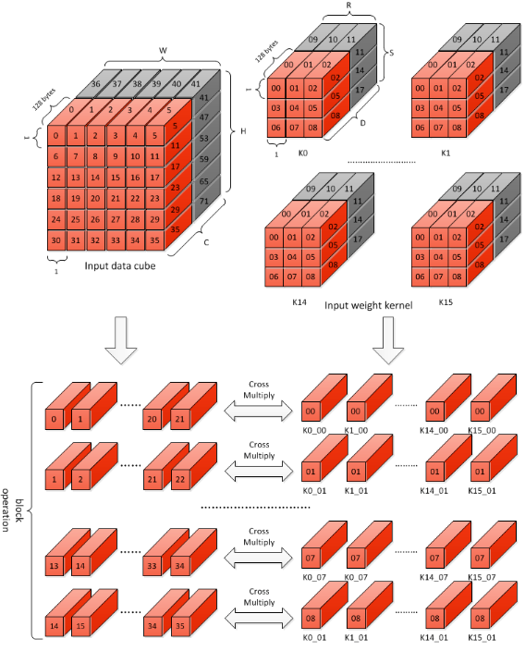
Block operation
Each kernel in a kernel group uses RxSx64 (since we’ve divide the weight into 1x1x64) weight elements.
Results add together across stripe operations.

Slide 22
NVDLA simulation on Timeloop
16 MAC Cells, each has 16 MACs rather than 64. This is for the balance on the number of MAC units between different hardware.
Parallel (split on hardware) on M, C only.
Share input buffer for all PEs.

Slide 23
SuperPoint CNN layer shapes
 | W | H | C | N | M | S | R | Wpad | Hpad | Wstride | Hstride | Computes
conv1a | 80 | 60 | 1 | 1 | 64 | 3 | 3 | 1 | 1 | 1 | 1 | 2764800
conv1b | 80 | 60 | 64 | 1 | 64 | 3 | 3 | 1 | 1 | 1 | 1 | 176947200
conv2a | 80 | 60 | 64 | 1 | 64 | 3 | 3 | 1 | 1 | 1 | 1 | 176947200
conv2b | 80 | 60 | 64 | 1 | 64 | 3 | 3 | 1 | 1 | 1 | 1 | 176947200
conv3a | 80 | 60 | 64 | 1 | 128 | 3 | 3 | 1 | 1 | 1 | 1 | 353894400
conv3b | 80 | 60 | 128 | 1 | 128 | 3 | 3 | 1 | 1 | 1 | 1 | 707788800
conv4a | 80 | 60 | 128 | 1 | 128 | 3 | 3 | 1 | 1 | 1 | 1 | 707788800
conv4b | 80 | 60 | 128 | 1 | 128 | 3 | 3 | 1 | 1 | 1 | 1 | 707788800
convPa | 80 | 60 | 128 | 1 | 256 | 3 | 3 | 1 | 1 | 1 | 1 | 1415577600
convPb | 80 | 60 | 256 | 1 | 65 | 1 | 1 | 0 | 0 | 1 | 1 | 79872000
convDa | 80 | 60 | 128 | 1 | 256 | 3 | 3 | 1 | 1 | 1 | 1 | 1415577600
convDb | 80 | 60 | 256 | 1 | 256 | 1 | 1 | 0 | 0 | 1 | 1 | 314572800
share
Detector
Head
Discriptor
Head

Slide 24
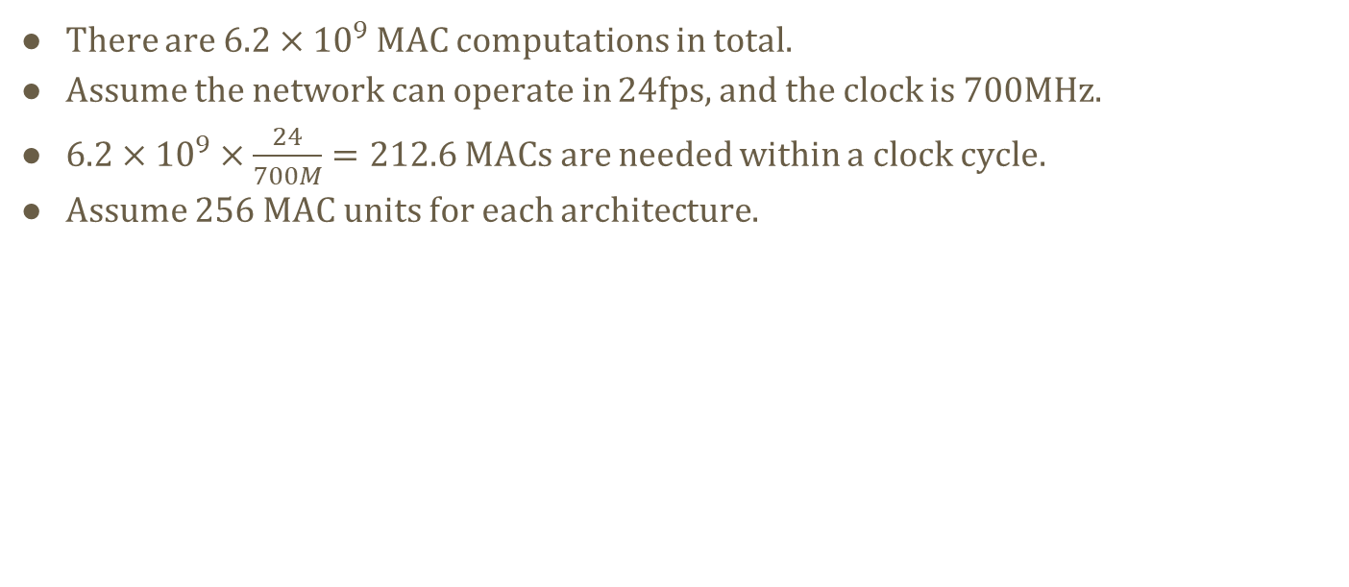
Assumption for simulation
There are $6.2×{10}^{9}$ MAC computations in total.
Assume the network can operate in 24fps, and the clock is 700MHz.
$6.2×{10}^{9}×\frac{24}{700M}=212.6$ MACs are needed within a clock cycle.
Assume 256 MAC units for each architecture.

Slide 25
Utilization & pJ/Compute
Eyeriss
conv1a:Utilization = 0.28 | pJ/Compute = 23.85 (C = 1)
conv1b:Utilization = 0.75 | pJ/Compute = 8.58
conv3a:Utilization = 0.75 | pJ/Compute = 8.13
conv3b:Utilization = 0.75 | pJ/Compute = 8.02
convDa:Utilization = 0.75 | pJ/Compute = 7.79
convPb:Utilization = 0.81 | pJ/Compute = 8.270
convDb:Utilization = 1.00 | pJ/Compute = 6.34 (R = 1)

Slide 26
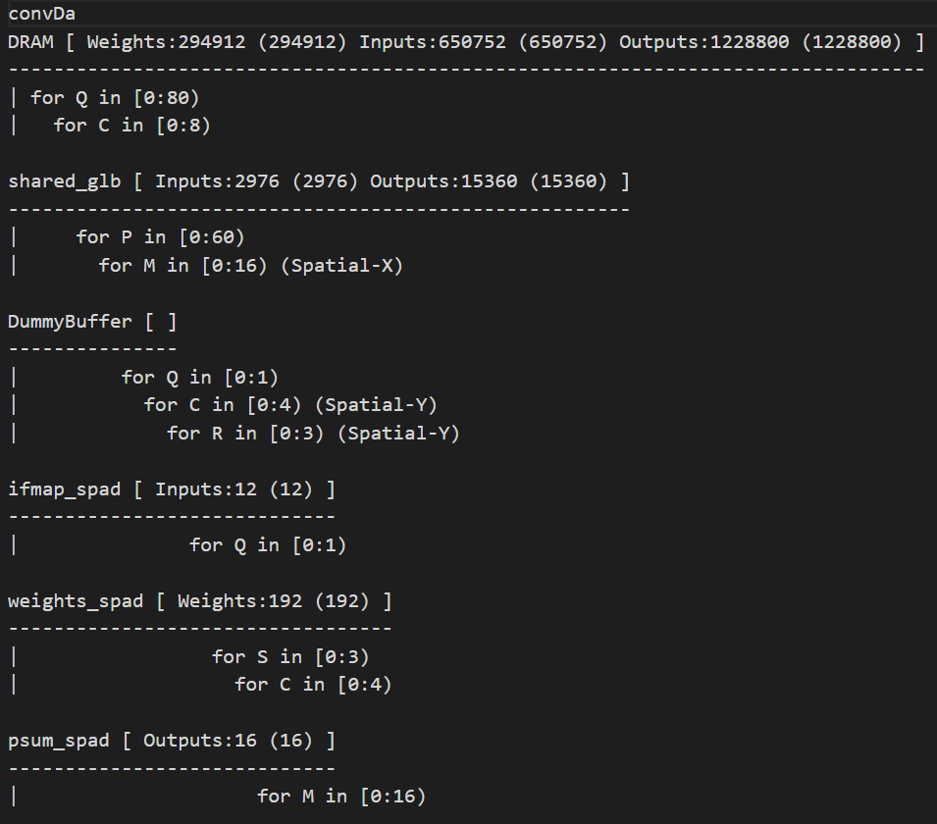
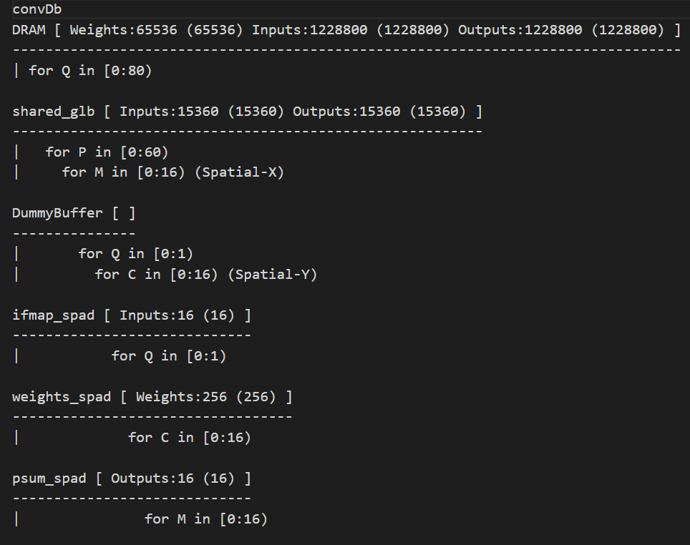
Take a look into the mapping
 | W | H | C | N | M | S | R
convDa | 80 | 60 | 128 | 1 | 256 | 3 | 3
convDb | 80 | 60 | 256 | 1 | 256 | 1 | 1

Slide 27
What’s wrong with convDa?
for C in [0:4):
PE array (16x16)
Filter rows Channel0
R=3
Channel1
R=3
…
Channel4?
R=3
?

Slide 28
The index factorization problem
However, Timeloop doesn’t find the mapping of channel number (C=5 on Spatial-Y) that is obviously better than the mapping it gives.
This is because Timeloop only consider the factorization of each dimension. For example, if C = 16, then only 1, 2, 4, 8, 16 are consider when building mapspace.

Slide 29
Padding the problem size(try on conv1b)
conv1b(C=64): Utilization = 0.75 | pJ/Compute = 8.58
conv1b(C=65): Utilization = 0.94 | pJ/Compute = 9.21
conv1b(C=75): Utilization = 0.94 | pJ/Compute = 8.45
However, this padding method will cause mis-estimation on cycle and computes, as well as the result energy.

Slide 30
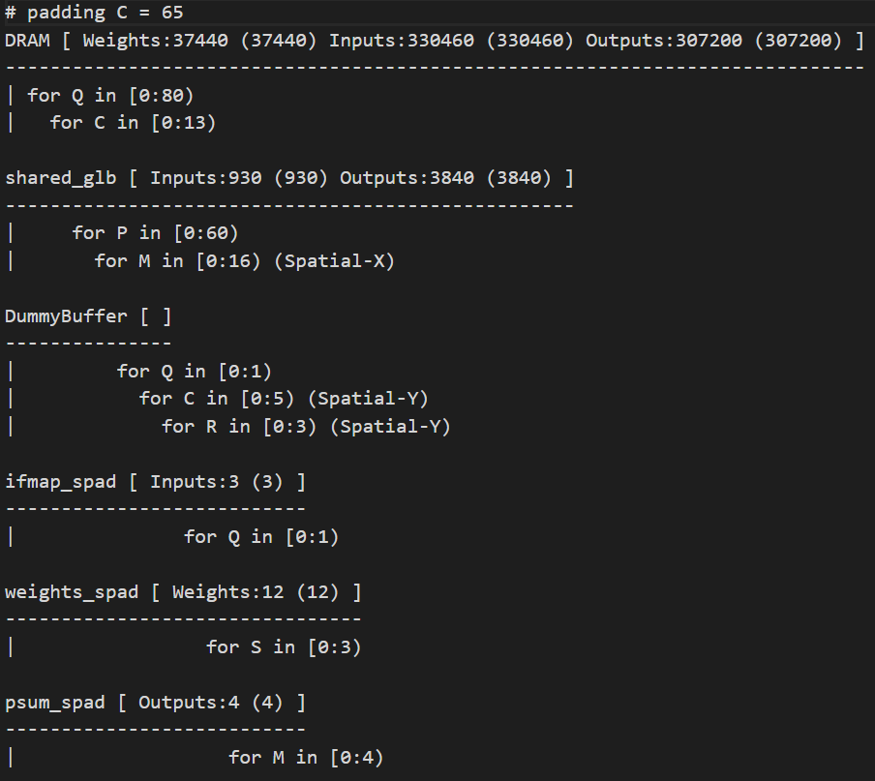
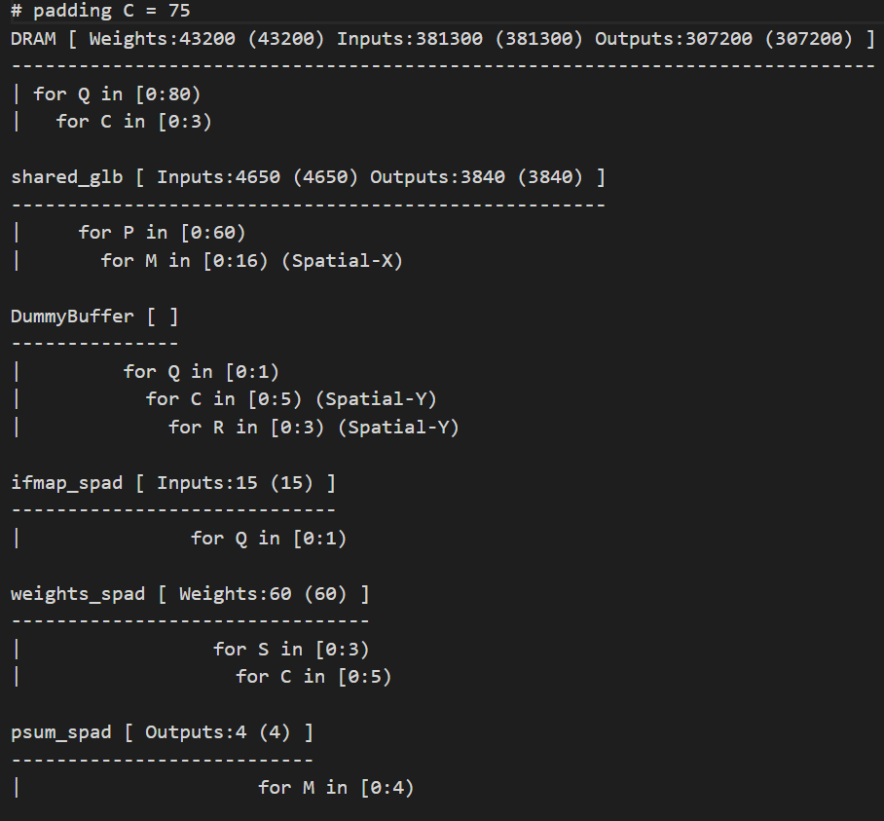
Padding the problem size(try on conv1b)
C=65
C=75

Slide 31
Utilization & pJ/Compute(TPU-like)
TPU-like
conv1a:Utilization = 0.56 | pJ/Compute = 20.803
conv1b:Utilization = 1.00 | pJ/Compute = 10.88
conv3a:Utilization = 1.00 | pJ/Compute = 9.83
conv3b:Utilization = 1.00 | pJ/Compute = 11.08
convDa:Utilization = 1.00 | pJ/Compute = 10.47
convPb:Utilization = 0.81 | pJ/Compute = 15.48
convDb:Utilization = 1.00 | pJ/Compute = 13.97

Slide 32
Utilization & pJ/Compute(NVDLA-like)
NVDLA-like
conv1a:Utilization = 0.25 | pJ/Compute = 25.91
conv1b:Utilization = 1.00 | pJ/Compute = 6.87
conv3a:Utilization = 1.00 | pJ/Compute = 6.66
conv3b:Utilization = 1.00 | pJ/Compute = 6.74
convDa:Utilization = 1.00 | pJ/Compute = 6.57
convPb:Utilization = 0.25 | pJ/Compute = 19.39 (Mapping problem, M=65)
convPb(padding M=68): Utilization = 1.00 | pJ/Compute = 11.13
convDb:Utilization = 1.00 | pJ/Compute = 8.00

Slide 33
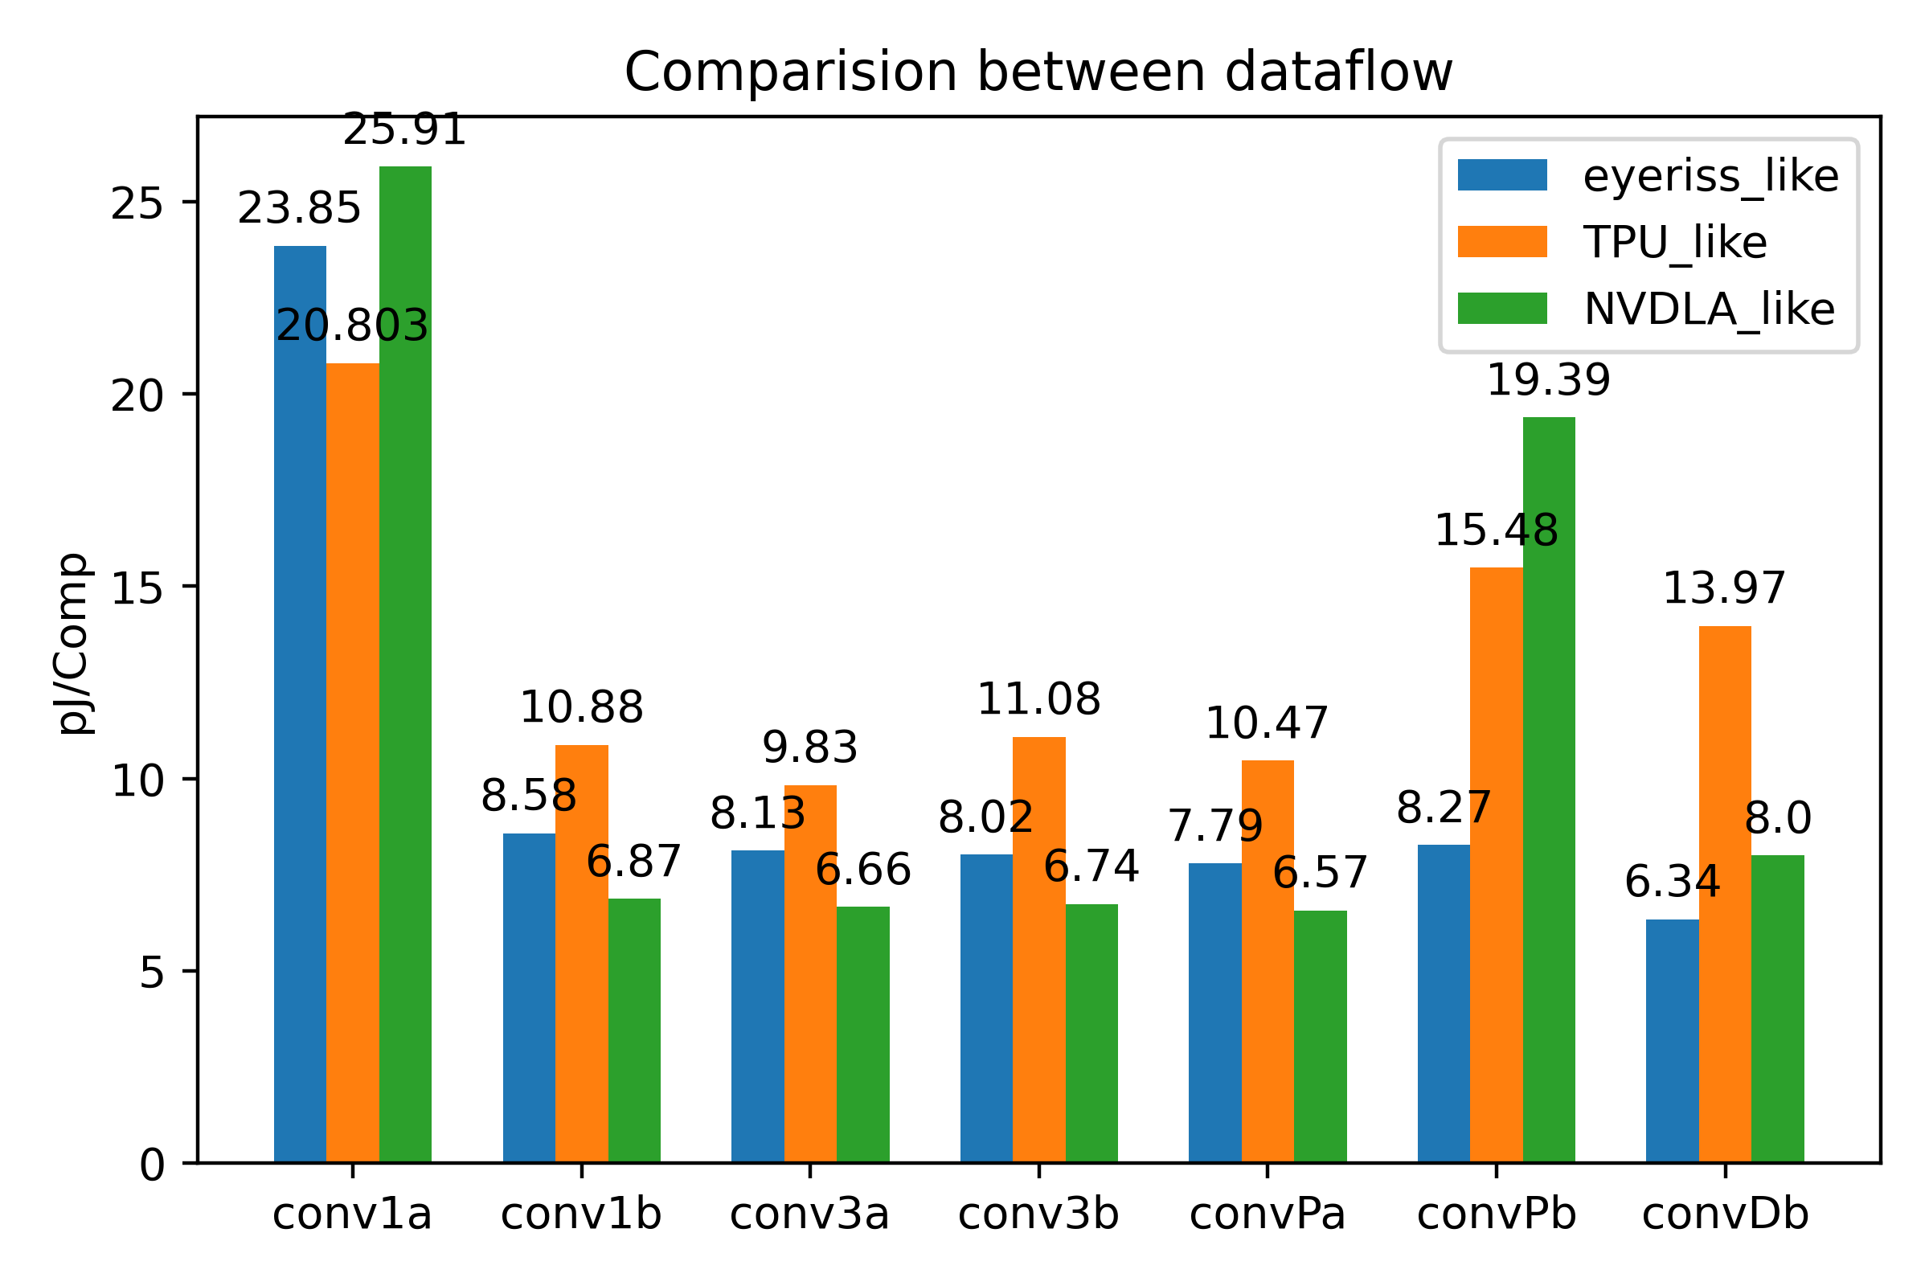
Comparison
NVDLA-like outperforms other dataflow in this network except the input layer and the output fully connected layer.
Compare to Eyeriss-like, it can achieve a higher theoretical utilization.
Compare to TPU-like, it can achieve a lower pJ/Comp. since it uses more local buffer to reduce the DRAM and GLB access.

Slide 34
Conclusion(1/2)
TPU has lower pJ/Comp. on the input layer, because it can assign the mapping with less constraint, which leads to higher utilization rate.

Slide 35
Conclusion(2/2)
Eyeriss can perform better than others when they are all on the perfect utilization rate, but the architecture must be design carefully to achieve fully utilized on each layer.

Slide 36
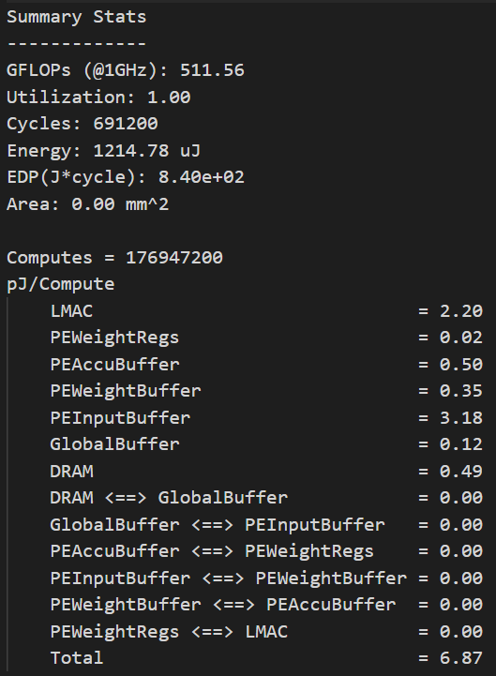
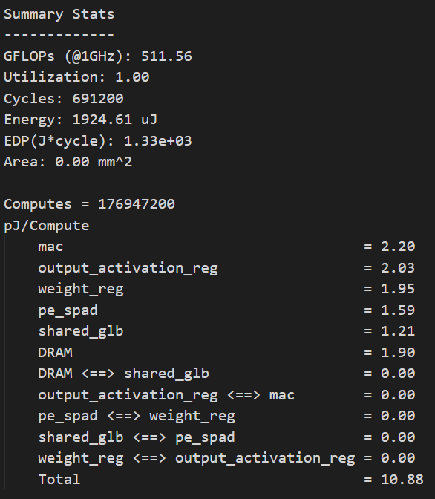
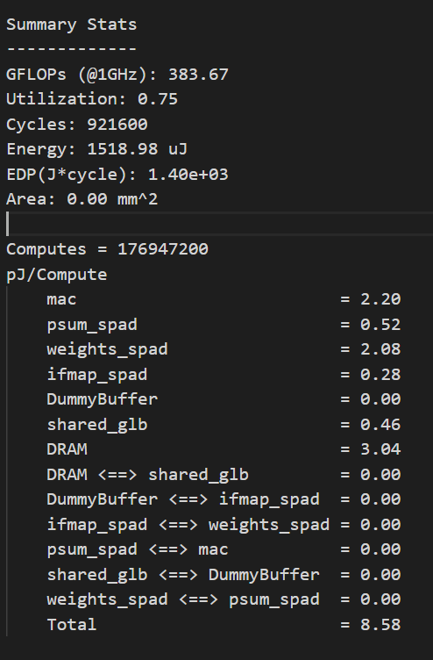
Comparison
Take Conv1b as example:
NVDLA
TPU
Eyeriss

Slide 37
future work
Find some previous work on the comparison of energy and utilization between different dataflow for the validation of simulation.
Try to deal with the index factorization problem by modify the source code, since manually find the optimal padding for each dimension is impractical.

